Slide 1
Build Your Social Presence
The collaboration that occurs between customers and between employees is the root focus of social business.
It is to say that in addition to these types of marketing campaigns, social business programs are centered on core business objectives and expressed through an appeal to the lifestyles, passion, and causes of customers.
These types of programs are specifically put in place to encourage collaborative participation.
So The primary challenge is therefore to align or connect the firm or organization to an existing community or to build one around an existing lifestyle, passion, or cause that connects to the core business.

Slide 2
Cont…
In following Figure, the fundamental relationship between experiences that are talked about (word of mouth), community participation, and the function of the brand outpost is shown.

Slide 3
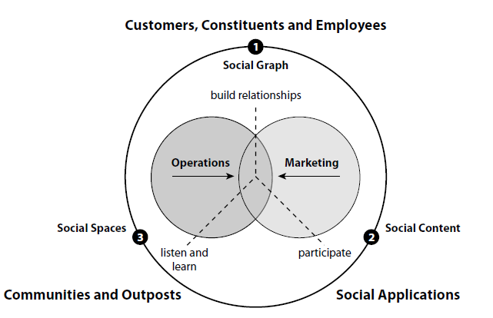
Cont…

Slide 4
Business as a Social Participant
People gather around a shared interest, cause, or lifestyle in pursuit of a sense of collective experience.
Important to understand is that they are often motivated by an apparent desire to talk about a brand, product, or service experience with each other, relating this to what they have in common.
What they have in common may in part be that brand, product, or service, but it is generally also something deeper.
Employees and customers, together through collaboration, create the experiences they want: Together they are responsible for the business. When the conversations that result are a reflection of this shared interest of both customers and employees, the conversations themselves are very likely to be powerful expressions that carry the business or organization forward.

Slide 5
Brand Outposts
As a result of the growth in social activities on the Web, there is a natural expectation on the part of consumers to find the brands they love in the social sites they frequent.
As a matter of course, customers expect this kind of presence and participation.
In addition to the branded community efforts described prior, an alternative (or complementary) approach to connecting a brand or organization with an existing community also exists: The creation of brand presence known as a brand outpost within an established social network or online community a Facebook Business Page, a Twitter presence or a YouTube channel to list just a few.
In creating a brand outpost in comparison to a self-standing community there need not be any reason other than the expectation for the brand to be present and a tie back to business objectives that are served by such a presence. There does, of course, need to be a relevant contribution by the brand, product, or service to the community it wishes to join.

Slide 6
Social Business and Measurement
Before diving into the use of social media in business, consider the basic measurement methods as they apply to the business use of social technology.
As an initial step into the integration of metrics within your social programs, however and to get you thinking about this aspect of undertaking a social business effort consider the assessment of participation, applied knowledge transfer, and the measurement of social activity in general as a starting point to a quantitative guide in building and running your social business.

Slide 7
Collaborate
Collaboration sitting atop the engagement process is the defining expression of measurable engagement.
Collaboration between community members, between employees, or between a firm and its representatives comes about when both parties in the transaction see a value in completing the transaction, often repeatedly.
Think about counting the number of collaborative processes that lead to a solution, or the number of shared results.
Each is an indicator of the respective participant’s willingness to put effort into such processes.

Slide 8
Participation
Participation is likely one of the easiest metrics to capture and track.
Indicators of participation can be gathered from existing measures content creation, curation, and the number of reviews, comments, and posts and can then be used to assess the overall levels of interest and activity within online communities.
At the most basic level, as with any online interaction, the activity itself can be tracked.
Accessing a page, submitting a form, downloading a fi le and similar content measures provide a well-understood framework for measurement.

Slide 9
Cont..
In a 2010 interview, Bill Johnston, now with Dell, talks with Rawn Shah,Practice Lead for IBM’s Social Software Adoption effort, about assessing internal versus external participation:
Internally we have a closed population of users where we know all the individuals involved. Therefore our internal metrics can be focused down to the activities of specifi c groups and populations of individuals—we avoid getting down to specifi c individuals to protect privacy—so we can assess participation based on organizational role: regional versus global sales, for example. Externally however, the population is much more mixed and rarely do we have data per specifi cally identifi ed people. This leads us to very different types of behavioral information: internally we can categorize users by their level of participation (zero, low, medium, high, elite) in our social environments, and then examine the actions or distribution of these member across the geographies. With the external environment, social media monitoring tools and services from other companies allow us to take the pulse of activity along different topics. We then have to infer behavior based on the level of interest in topics across the Web.

Slide 10
Applied Knowledge Transfer
Understanding and tracking participation is obviously important in managing the growth and development of a collaborative community.
However, participation is only half the challenge. Participation speaks to action but not necessarily value.
How do we keep from spinning in circles? By tying levels of participation and collaboration to an ultimate end point: the accumulation of applied knowledge for example, a wiki of customer solutions that have been tested and are known to work in the context of specific business objectives.

Slide 11
Social Activity
In addition to the measures of what is happening within the community, brand outpost or the internal online workspace, where the activities are occurring also lends itself to measurement.
Starting with social profiles, one of the easiest (and as it turns out most important) metrics to keep track of is profile completeness. Long ago, LinkedIn implemented an easy-to-understand indicator of profile completeness: Does a specific profile include a picture, an address, and contact information, for example? Because this information is often central to creating a relationship, the average state of completion is worth knowing. Profile data, actual content production, and community reputation are the primary visible attributes on which a decision to accept a connection request are based. Be sure that you have a way to assess these.

